Slide 1
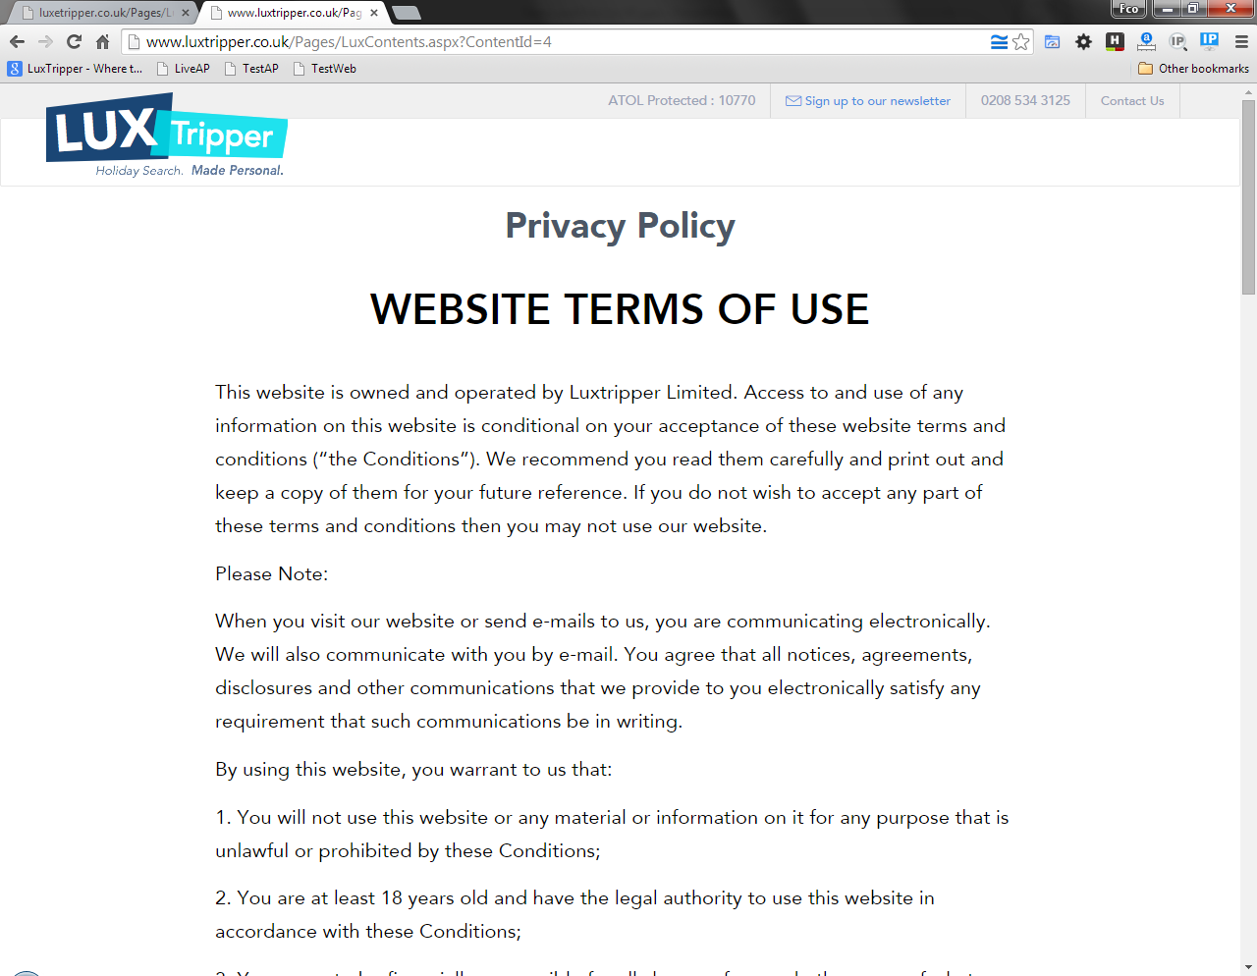
This is what we have in LIVESRV

Slide 2
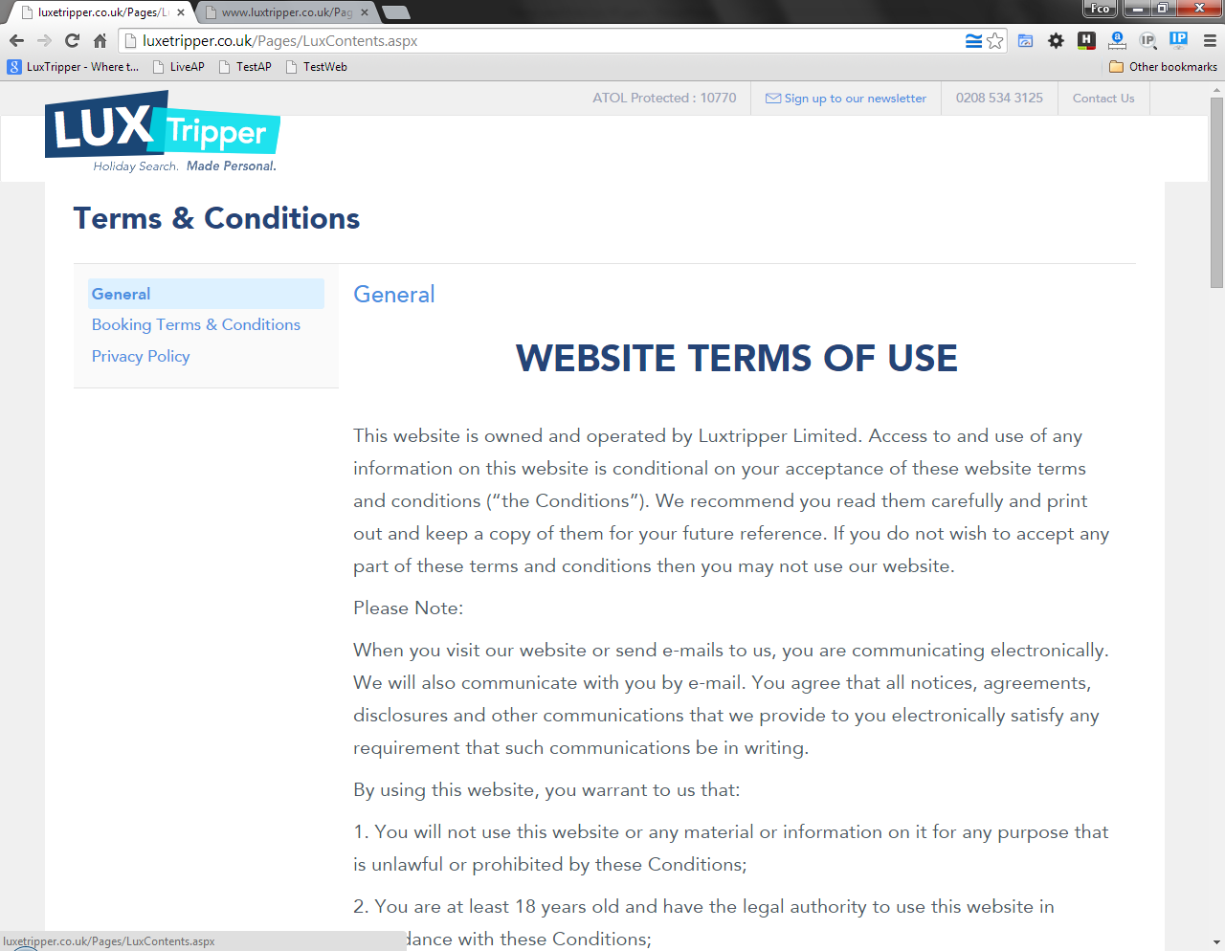
This is what we have in TESTSRV and what we want in LIVESRV with the following changes made:
1. This link the text has to be
“Website terms of use”
2. Add another link there to go to “Safety and security” page

Slide 3
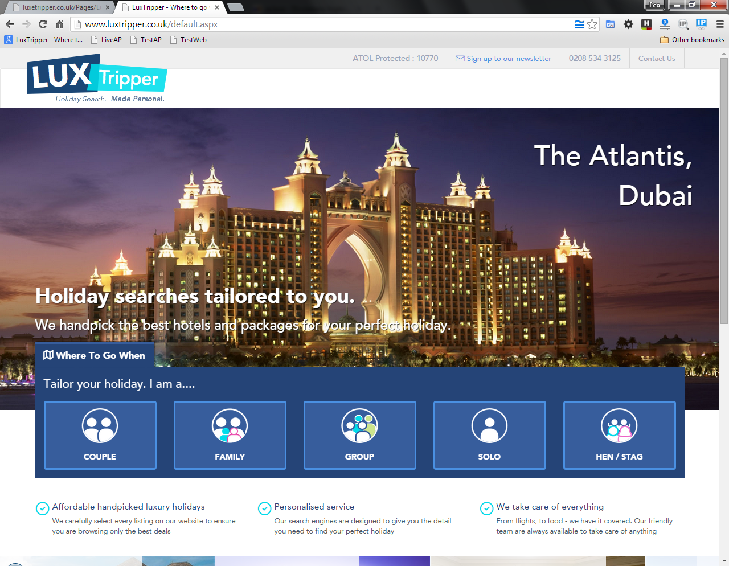
Besides we need to hide the “Contact us” link
Hide “Contact us” link

